Slide 1
Exploratory Testing In Software Testing

Slide 2
What is Exploratory Testing?
“Exploratory testing” – as the name suggests, is a simultaneous learning, test design, and test execution process
The exploratory testing process has four main steps. These are as follows:
Learn: This step identifies the user and the objective. Also, find the requirements for the test.
Test design: Test design briefly describes the test instead of a test case. It links the test to the requirements.
Test Execution: Test execution executes the test and finds out the results.
Test Analysis: This step analyzes the test and results. It creates reports of the defects.

Slide 3
For Example, if you open a shopping website, you have a general idea that this shopping website will let you shop by selecting a product of your choice and then paying for the same.
During this process, you might learn that the website provides you with virtual human look-alike which helps you in product selection process. You also found that you can order a number of products for home trial or that you can make payment through rewards points of some banks, etc.
As a tester, you not only need to verify whether a system is working as expected but also check if that system is not behaving in a way which is not expected.

Slide 4
When use exploratory testing?
The testing team has experienced testers
Early iteration is required
Incomplete Documentation
New testers entered into the team
Limited Time for testing
Find new tests

Slide 5
Exploratory Testing Example
A home care service provider website with the following components:
Login
Services
Cart
Payment
Order History
Technician allotment
A general idea to start exploratory testing will be to Login or book a service.

Slide 6
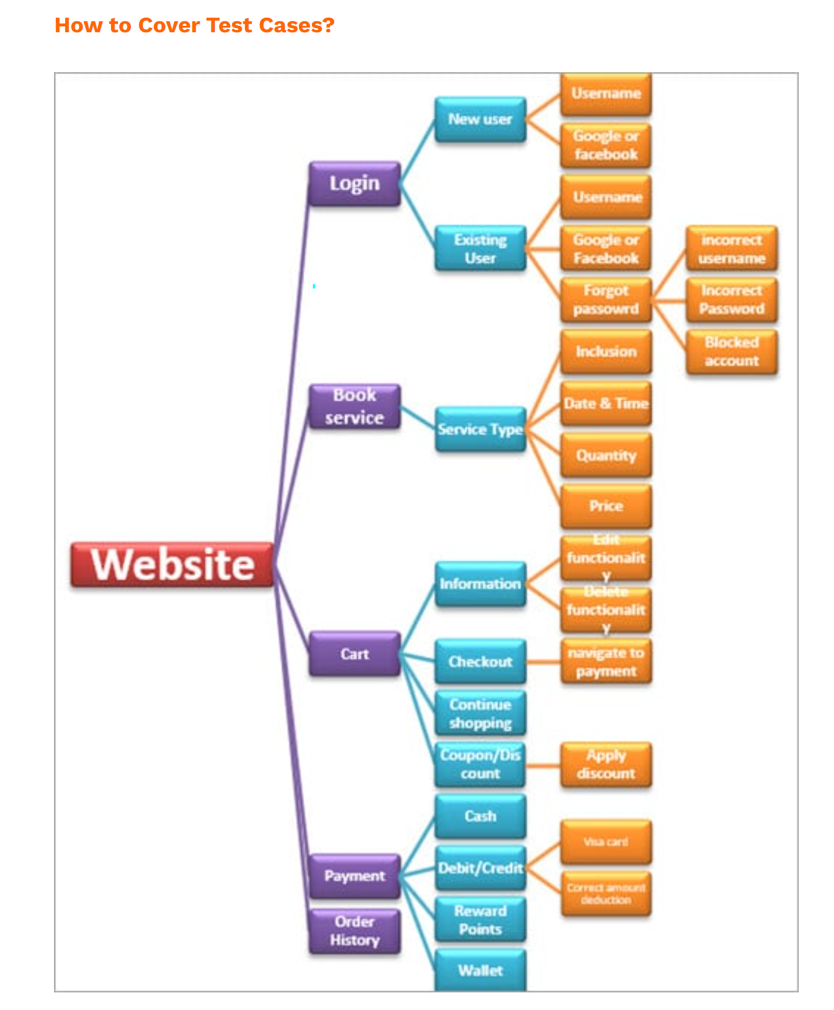

Slide 7
In the above Example, the idea is to start with functionality based on your knowledge. As you learn and observe more about the application, you can govern your next set of test cases.

Slide 8
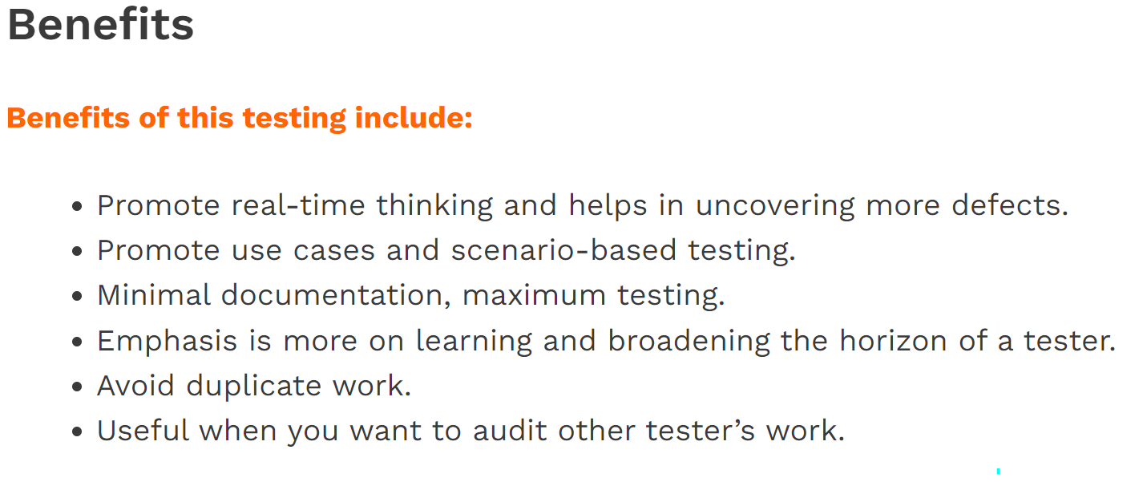
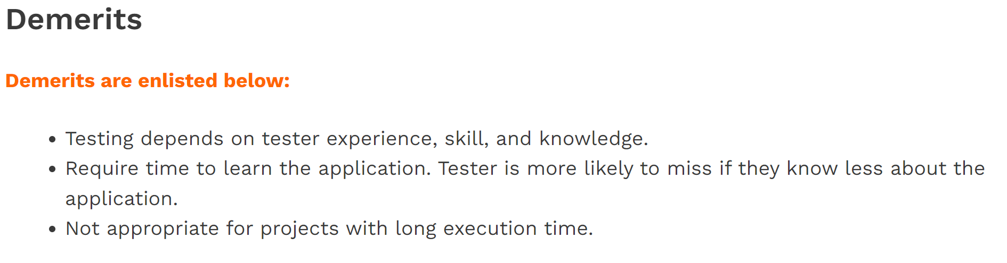

Slide 9
Session-based Exploratory Testing
While doing exploratory testing, it’s very difficult for testers to put into words on how much he has tested and on what basis.
Basically, it’s difficult to quantify the work and the time spent.
Session-based testing is a time basis approach to perform this testing which helps in managing and tracking. It includes a dedicated time-boxed testing session with no interruption from email, phone, messages etc.

Slide 10
Approach:
Testing tasks are divided into sessions.
Following are the components of session-based testing (SBT):
Mission: Mission shout out the purpose of the session and in a way provide the focus for the tester. It will also include a session time duration.
Charter: Includes the scope of the testing. Basically, an agenda detailing the goals that need to be completed during the session.
Session: Pre-defined time-boxed testing session without any interruption. Each session can have the following duration:
“Short” (60min)
“Normal” (90min)
“Long” (120 min)
Session report: Include notes and lightweight report to provide metrics to the leaders and managers. It gives details about the charter session remaining or done, session setup time, scenario tested, about the testing process, a list of bugs and the issues found and other information for the metrics.
Session De-brief: A short meeting or stand-up between the tester and Test Lead/Manager to review the test session findings.

Slide 11
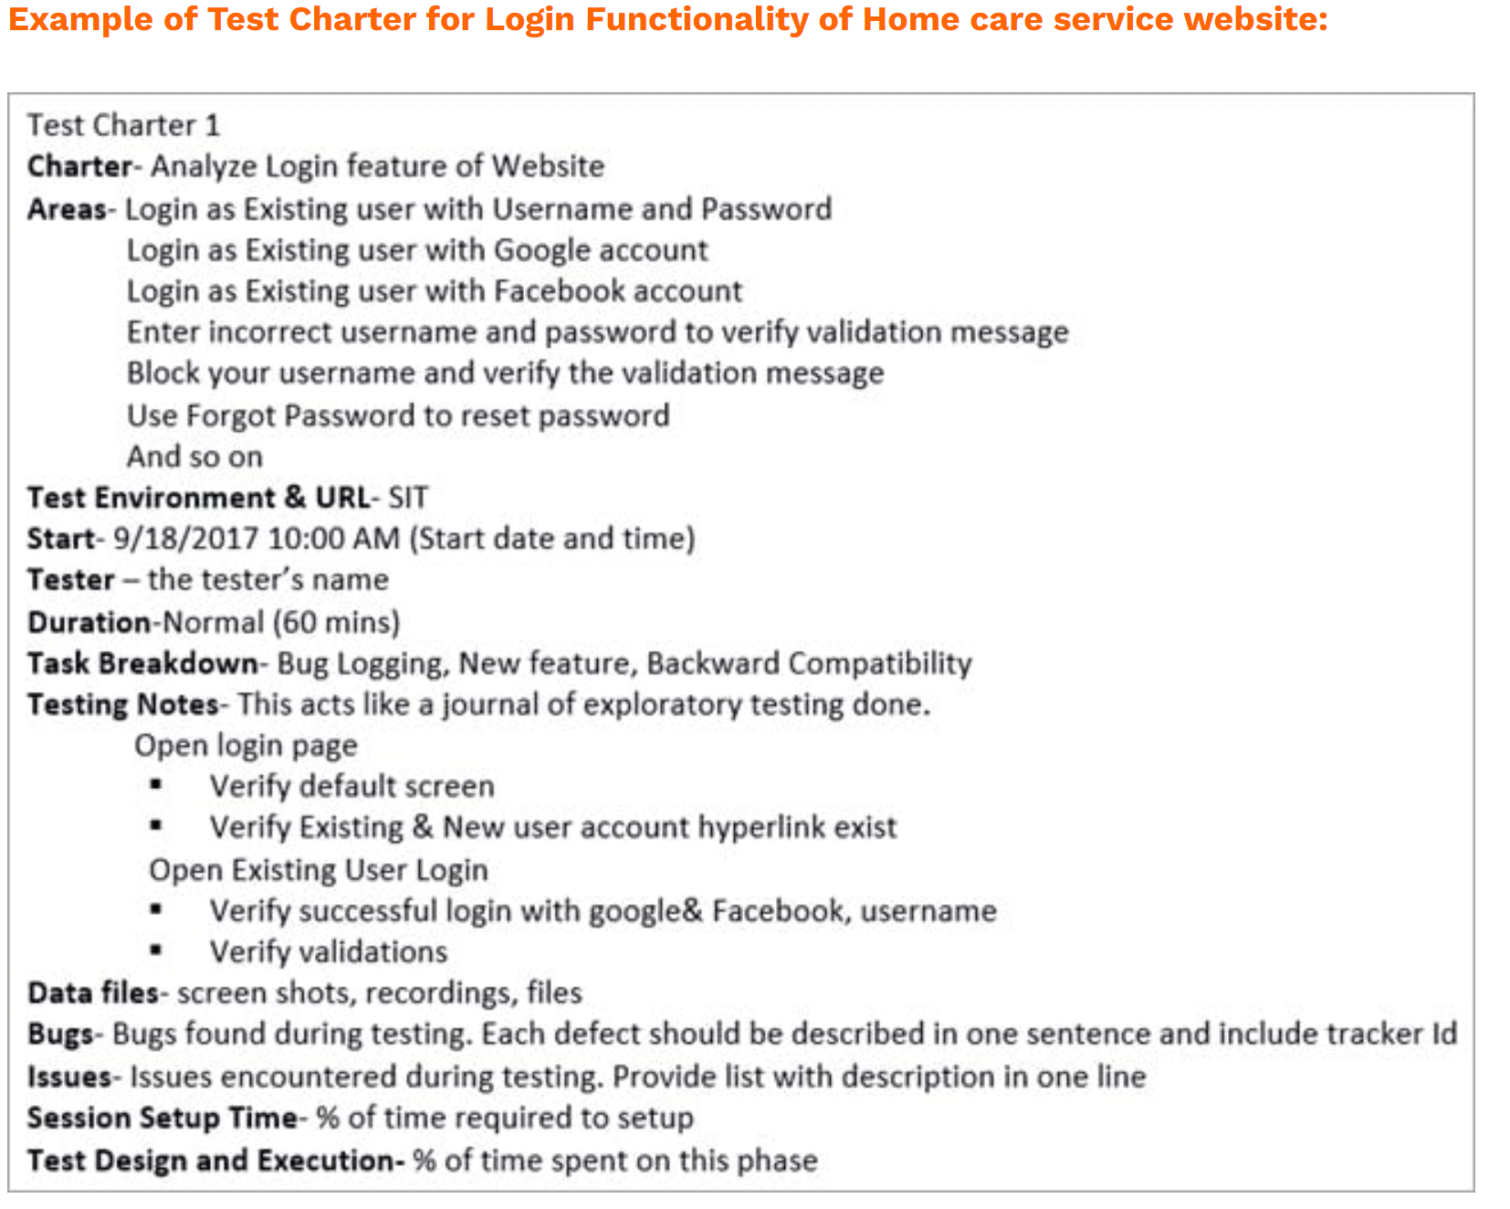

Slide 12
Pair Based Exploratory Testing
Pair Testing is an approach in which two people test the same thing/feature of the application at the same time by sharing a PC. They continuously share their thoughts and ideas. During this testing, one person takes charge of the keyboard whereas the other person suggests test cases and takes note.
Helps a tester to focus on the task at hand.
Encourage mutual trust and respect among partners.
Brainstorming between paired testers usually, lead to more constructive ideas.
Avoid tunnel vision.
There is a lesser chance of others interrupting them.

Slide 13
Exploratory Testing Technique—TOURS
It is a simple technique which allows a tester to use his imagination and think of himself as a tourist exploring a city he visits.
Here an application to test is the city and the testers are the tourists.
A tourist can take the following tours:
Guidebook tour – Testing highlighted feature of the application. Use user-based scenarios.
Exploring the history of the city – Test old features of an application.
Money tour, which means making sure that all the critical features in reference to the customer or client are tested and working successfully.
Crime spree tour – Enter invalid input and test negative scenarios.
Back alley tour – Test the least used features of the application.
Boring tour – Spend minimum time on each screen of the application, fill minimum fields and take the shortest path. This will help with the default value and validation testing.
While taking a tour, you always have the choice of taking any route. You can navigate through software and find a unique path to test the feature.

Slide 14
Types of Exploratory Testing
1) Freestyle ET:
Exploration of application in ad-hoc style.
In this type of ET, there are no rules, no account for coverage, etc. However, this type of testing is good when you need to familiarize with the application quickly, when you want to verify the work of the other testers, and when you want to investigate a defect or want to do a quick smoke test.

Slide 15
However….
Do not confuse ET with Ad-hoc testing.
Ad-hoc testing refers to a process of unscripted, unplanned and impromptu defect searching whereas exploratory testing is a thoughtful methodology to Ad-hoc testing.
Ad-hoc testing is a hit and trial method of finding a bug whereas ET is not. In ET approach, a tester learns about the system as they explore and eventually evolve the tests using the acquired knowledge.
Ad-hoc testing is an unstructured activity whereas ET is somewhat a structured activity.

Slide 16
2) Scenario-based ET:
As the name itself suggests, testing done is scenario-based. It starts with real user’s scenarios, end-to-end scenarios or test scenarios. After initial testing, testers can inject variation as per their learning and observation.
Scenarios are like a generic guide for what to do during ET. Testers are encouraged to explore multiple possible paths while executing a scenario to ensure all possible path to feature work. Testers should also ensure to gather as many scenarios as possible from different categories.

Slide 17
3) Strategy based ET:
Known testing techniques such as Boundary value analysis, equivalence technique, and risk-based technique that are combined with exploratory testing. An experienced tester or a tester who is familiar with the application is appointed for this type of testing.

